Slide 1

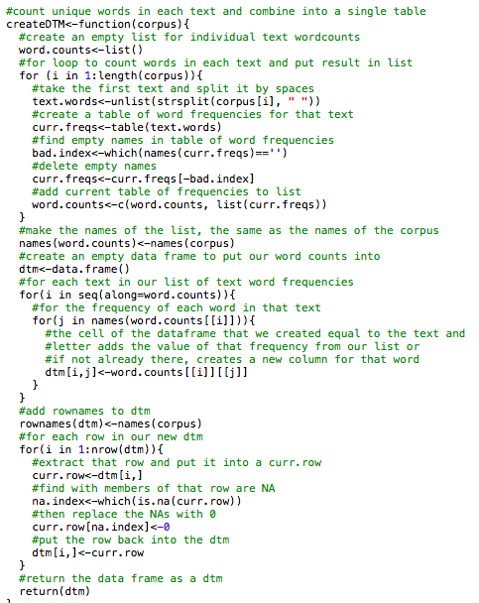
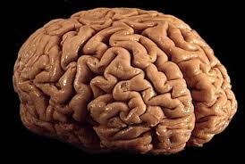
Computational analysis
Corpus Development
Intellectual analysis

Slide 2
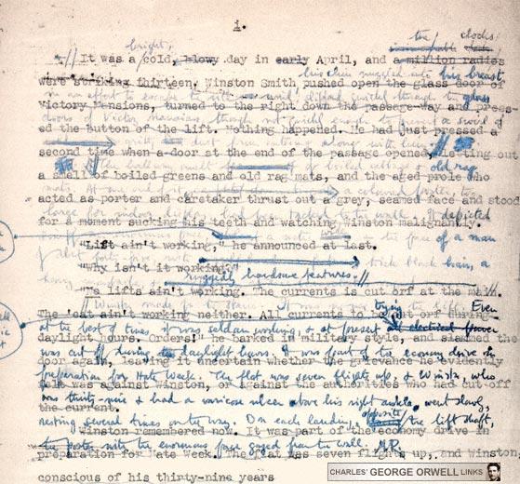
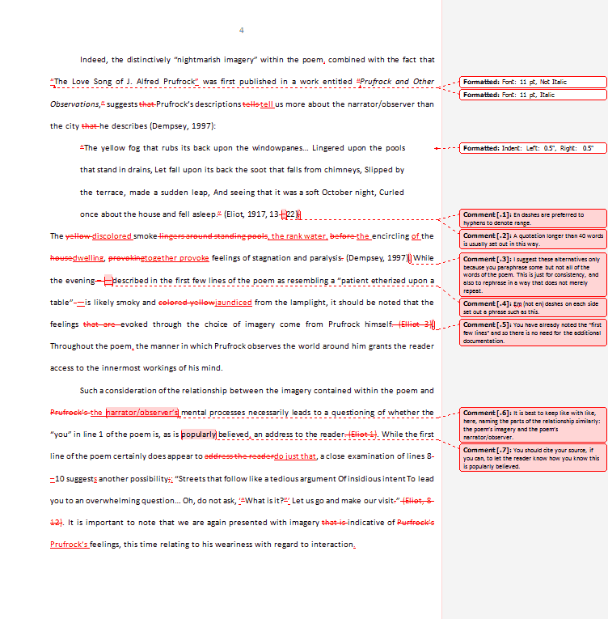
Notes:
Why an iterative and experimental model should be familiar in the humanities

Slide 3
Statistical Methods
Word frequency
Word proximity
Topic modeling

Slide 4
Natural Language Processing
Sentiment analysis
Named entity extraction
Parsing (tokens), syntactic parsing (parts of speech), semantic parsing

Slide 5
Inputs / The Foundation of Inquiry
Data
Metadata

Slide 6
Machine Learning
Supervised
Categorization
Prediction
Unsupervised
Clustering
Dimension reduction

Slide 7
How can we ask them?
Analyze the language in a document
Compare
Discover or explore
Test hypotheses

